Slide 2
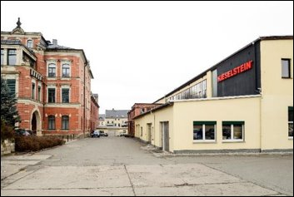
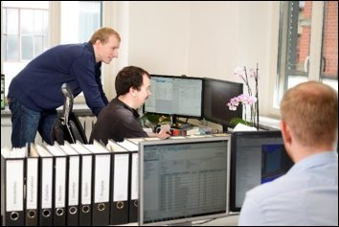
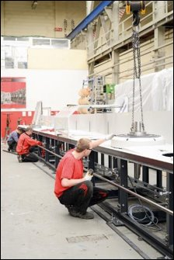
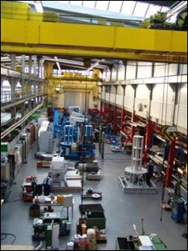
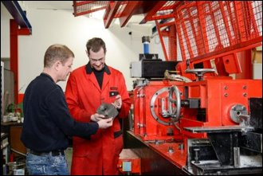
Head Office:​
​
Erzbergerstr. 3 ​ 09116 Chemnitz, Germany
​
Phone: +49 371 9104-1 00​
Fax: +49 371 9104-105
​
info@kieselstein.com​
www.kieselstein.com ​

Slide 3
TECHNOLOGY – Reference Projects
Shaving Machines for Non-Ferrous Metals
Advantages
Compact design of the machines allows the integration into existing lines
Stand-alone coil to coil, coil to spool or spool to spool lines available
Full lines can be offered with different kinds of pay-offs as well as take-up systems
Double shaving as an option to increase the removal of material
Technical Parameters
Inlet wire diameter | max. 32.00 mm
Shaving speed | max. 10.00 m/s
Cutting depth (per side) | 0.01 mm – 0.50 mm

Slide 4
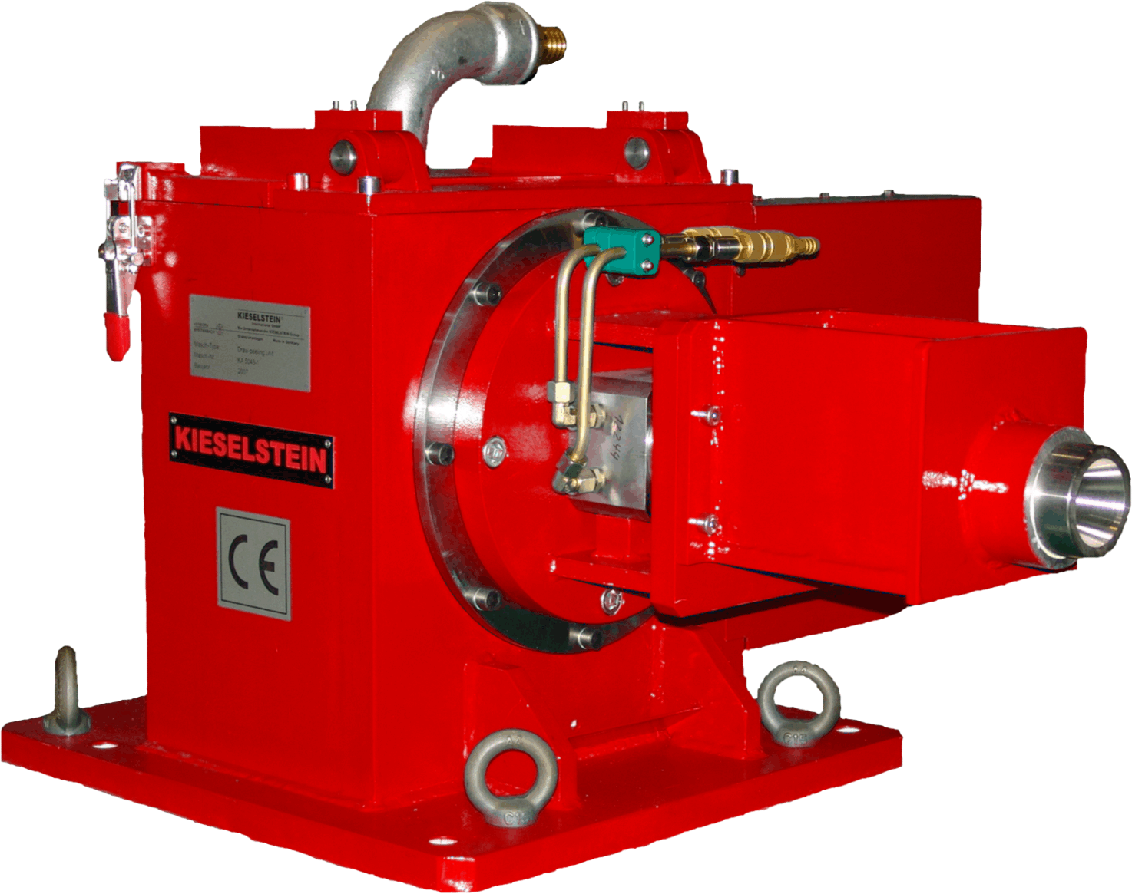
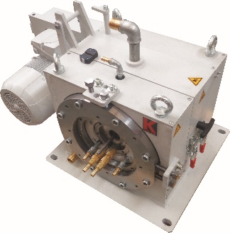
TECHNOLOGY – Reference Projects
Shaving Units for Large Range of applications
Advantages
Large range of units
Design for all kinds of wire materials
Individual design for special requirements
Double shaving unit for maximum cutting depth
New design for non-ferrous with minimum distance for pointing and very compact design for a simple integration
Technical Parameters
Inlet wire diameter | Max. 32.00 mm
Outlet wire diameter | Min. 0.80 mm
Cutting depth (per side) | 0.01 mm – 0.50 mm

Slide 5
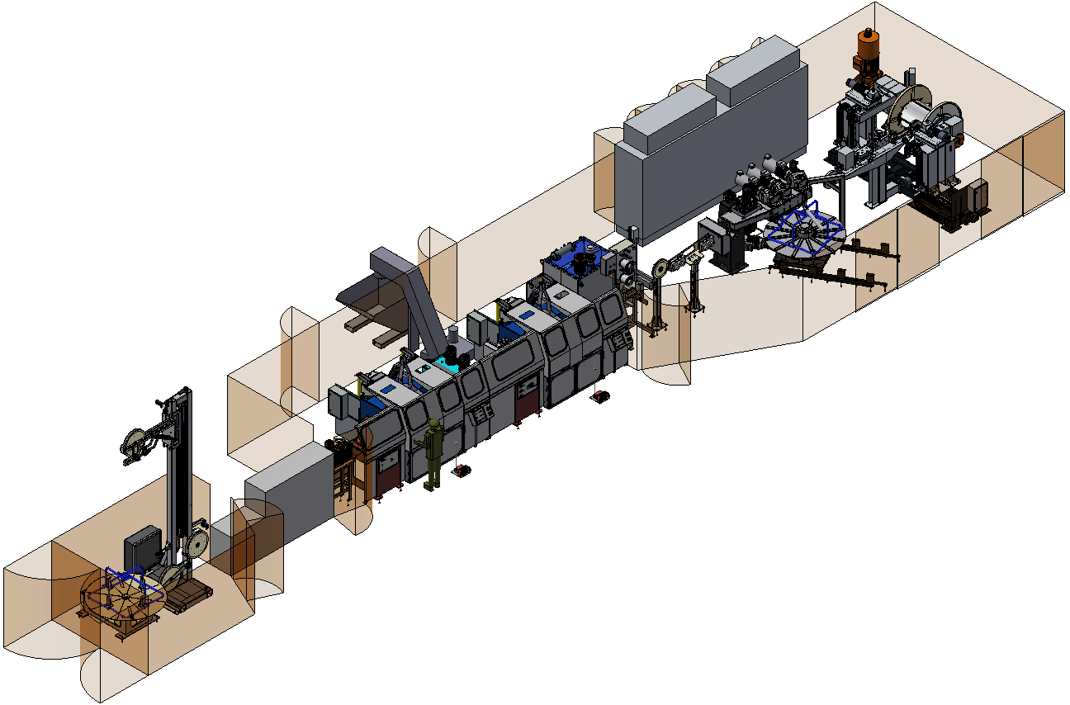
Reference Project:
Aluminium Shaving Line

Slide 6
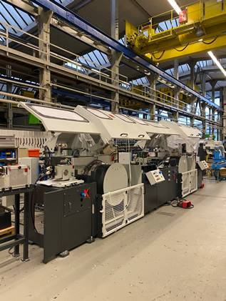
Reference Project:
Aluminium Shaving Line
Technological parameter:
Material: | Aluminium alloy (7050; 5056; 2117; 2017)
Diameter inlet wire: | max. 9.50 mm
Diameter finished wire: | min. 2.40 mm (in drawing process)
Block: | 2 pcs. (1x Drawing / 1x Shaving)
Drawing speed: | max. 180 m/min
Drawing capstan Ø: | 800 mm / Block
Manufacture option: | Coil to coil Coil to spool (Option)
Space requiered (LxBxH): | 27.000 mm x 9.000 mm x 5.200 mm

Slide 7
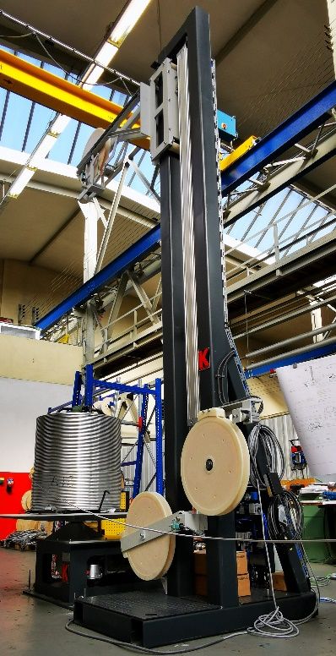
Reference Project:
Aluminium Shaving Line
Structure:
Designation: | Coil pay-off ABV-T-Ueko
Function: | The pay-off device offers the flexibility to feed wire rings or coils into the system in an overhead process or tangentially with a rotary plate.

Slide 8
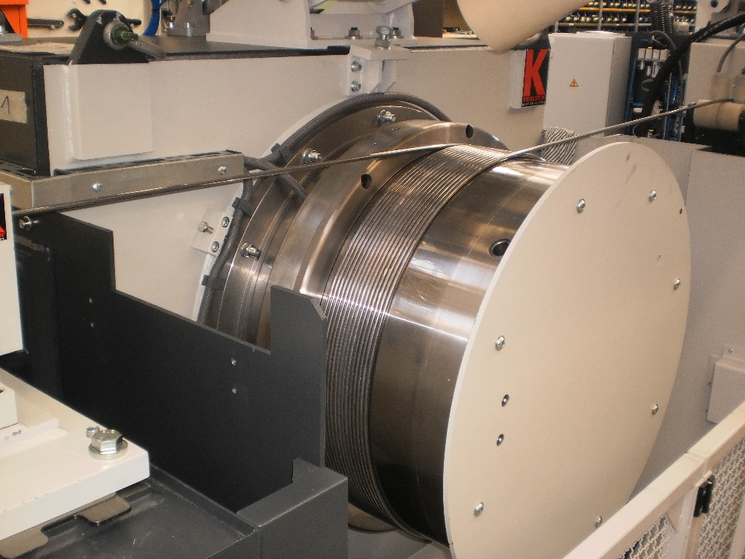
Reference Project:
Aluminium Shaving Line
Structure:
Designation: | Draw Shaving line EHN 10/2
Function: | The wire is guided to the drawing block by a straightening device, positioned in front of the machine. In the first step, the wire is drawn on the block, which is equipped with a shedding ring. The shedding ring ensures, that the wire is drawn without damaging the surface.

Slide 9
Reference Project:
Aluminium Shaving Line
Structure:
Designation: | Draw Shaving line EHN 10/2
Function: | In the second step, the shaving is done with the shaving unit DS-NE 150 positioned in front of the second block. The synchronisation of both blocks is done by a sensor roll. The unit can also be used for the pure drawing process.

Slide 10
Reference Project:
Aluminium Shaving Line
Structure:
Designation: | String cleaning
Function: | Serves to clean the wire from lubricant residues (drawing and shaving emulsion).

Slide 11
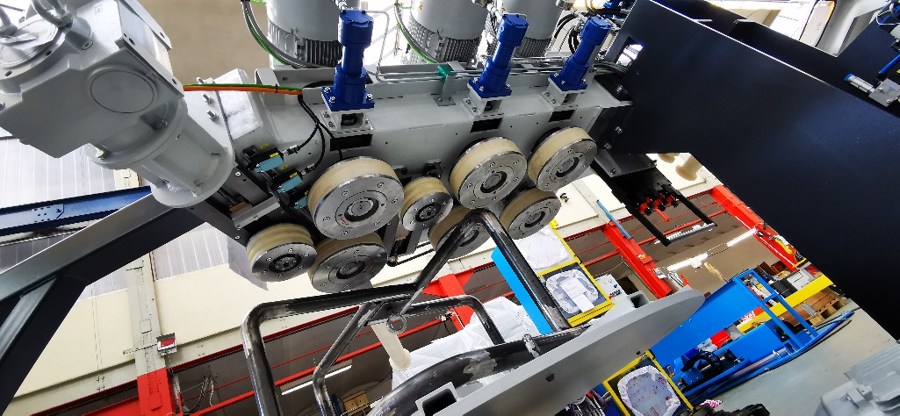
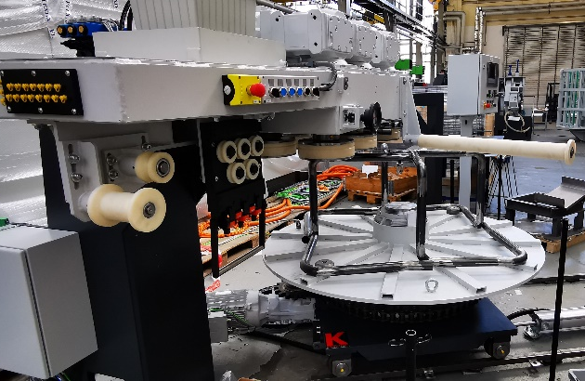
Reference Project:
Aluminium Shaving Line
Structure:
Designation: | Bending coiler BWV
Function: | Wire rings can be produced at a speed of up to 180 m/min. The rotating wire take-up supports the packaging in the line. The adjustable bending roller allows flexible adjustment of ring sizes.

Slide 12
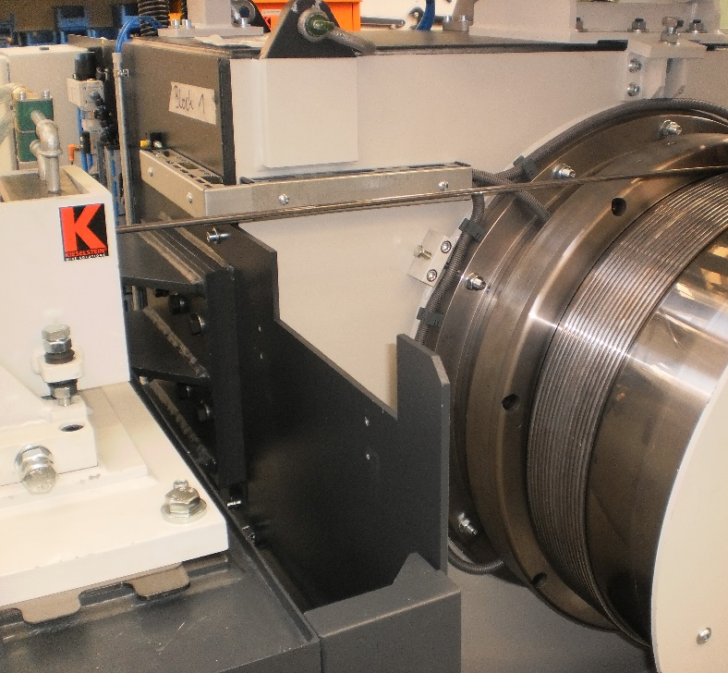
Reference Project:
Aluminium Shaving Line
Structure :
 | Further components: Spooling machine SH-Tr 1250 (Option – not yet included in the scope of supply) Drawing oil supply Cutting oil supply Chip conveyor

Slide 13
Reference Project:
Aluminium Shaving Line
Why KIESELSTEIN?
Technologically mature holistic concept for the implementation of the shaving technology
Flexible production options:
Drawing with Shaving / Shaving /
winding on spools (optional) /
production of wire coils
Innovative ideas, for the further development of existing concepts

Slide 14
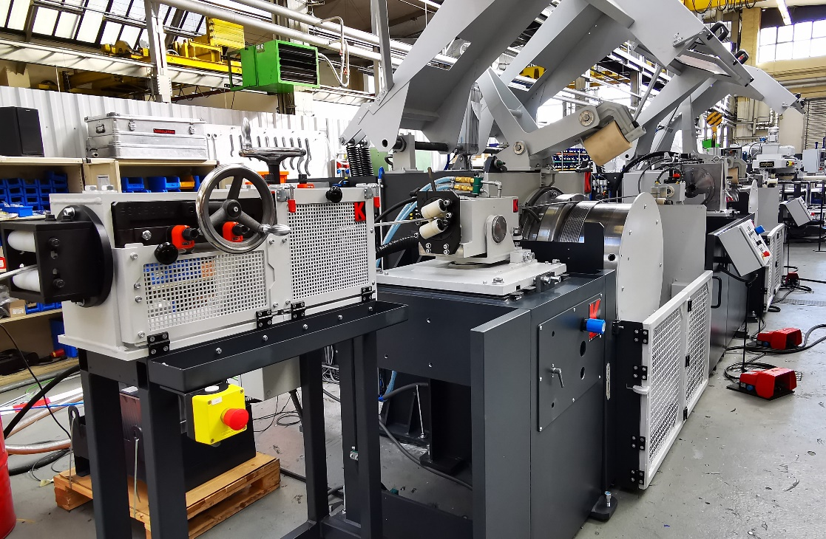
THANK YOU VERY MUCH FOR YOUR ATTENTION!

